Slide 1

Leaf Disease Detection And Remedy Suggestion
Using Deep Learning
Guided By: Mrs. Naseena N
Team Members :
Arjun A
Jonathan John
Muhammad Jalal
Najeeb

Slide 2
INTRODUCTION
Various diseases in plants are one of the major threats to food security which also affect the farmer’s livelihoods which depend on healthy crops. For optimum yield, the crops should be healthy, therefore some highly technical method to be used for periodic monitoring of crop.
The combination of increasing global smartphone and advances in computer vision made possible by deep learning and image processing, which made possible for diagnosing diseases and for suggesting a proper remedy.
This project is mainly being developed for the agricultural practices and hence being a helping hand for farmers.

Slide 3
OBJECTIVES
To develop a web based application that responds to inputs.
Provide list of remedies for reviving the diseased plant or its future occurrences
To modify the existing solution more efficiently to solve this problem in more genuine way.

Slide 4
PROBLEM STATEMENT
There are various diseases affecting plants. These diseases include bacterial , viral , fungal etc. Also farmers may not proper information about the symptoms and its remedies.
Hence we decided to develop a system with minimal technical constraints to identify the disease of a leaf and give suggestions for its cure.

Slide 5
Literature Review
“Deep neural networks based recognition of plant diseases by leaf image classification” by S. Slado Jevic, M. Arsenovic, A. Anderla, D. Culibrk, and D. Stefanovic
Presents the need to provide adequate data that can be used to identify the diseases accurately without confusing the ones that are closely related. The changes in weather, global warming, and other impacts have led to many diseases that have not been documented.

Slide 6
“Corrigendum: deep plant phenomics: a deep learning platform for complex plant phenotyping tasks” by J. Ubbens and I. Stavness
Presents the need to understand the phenotypes used in detecting diseases.a phenotype would be any observable characteristic or trait of a disease, such as morphology, development, biochemical or physiological properties, or behavior, without any implication of a mechanism . A clinical phenotype would be the presentation of a disease in a given individual. The phenotype used in the detection of diseases is usually a result of climate and weather.

Slide 7
“Image-based plant disease identification by deep learning meta-architectures” by M. H. Saleem, S. Khanchi, J. Potgieter, and K. M. Arif
Proposes a new approach aimed to the application of deep convolutional generative adversarial networks that help in the identification and analysis of the images. The contribution of the adversarial networks increases the accuracy of the detection process.The use of CNN methods could also be effective in dealing with the inaccuracy and slow identification processes of the diseases.

Slide 8
Proposed Model
The main purpose of proposed system is to detect the diseases of plant leaves by using feature extraction methods where features such as shape, color, and texture are taken into consideration.
Convolutional neural network (CNN), a machine learning technique is used in classifying the plant leaves into healthy or diseased and if it is a diseased plant leaf, CNN will give the name of that particular disease.
Suggesting remedies for particular disease is made which will help in growing healthy plants and improve the productivity.

Slide 9
Design Flow Diagrams
User
Plant Leaf Image
System
Predicts Disease
User
Suggests Remedy

Slide 10
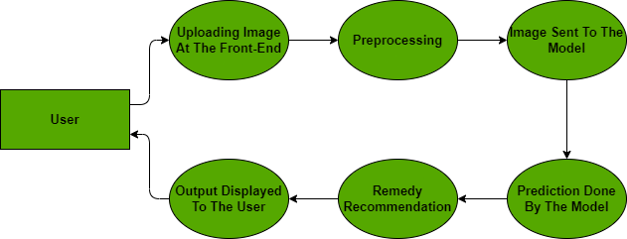

Slide 11
System Requirements
Hardware Requirements :
CPU: Intel Core I3 or above
Operation Speed: 2.0 GHz or above
RAM: 4GB or above
Software Requirements
OS: Windows
Development Language: Python 3.9.1
IDE: Visual Studio Code

Slide 12
Technologies Used
Languages :
Python : It is the programming language used in our project.It is a dynamic language which helps to write the code in fewer lines.The standard library offers all the things needed to build our complex applications.
Tools :
Google Colab : Colaboratory, or “Colab” for short, is a product from Google Research. Colab allows anybody to write and execute arbitrary python code through the browser, and is especially well suited to machine learning, data analysis and education.

Slide 13
Tensorflow : TensorFlow is a free and open-source software library for machine learning and artificial intelligence. It provides a collection of workflows to develop and train models using Python, and to easily deploy in the cloud, on-prem, in the browser, or on-device no matter what language is used.
OpenCV : OpenCV is a tool for image processing and performing computer vision tasks. It is an open-source library that can be used to perform tasks like face detection, objection tracking, landmark detection, and much more. It supports multiple languages including python, java C++.
Keras : Keras is a high-level, deep learning API developed by Google for implementing neural networks. It is written in Python and is used to make the implementation of neural networks easy. It also supports multiple backend neural network computation.

Slide 14
Flask : Flask is a micro web framework written in Python. It is classified as a microframework because it does not require particular tools or libraries. Flask is based on the Werkzeg WSGI toolkit and the Jinja2 template engine.

Slide 15
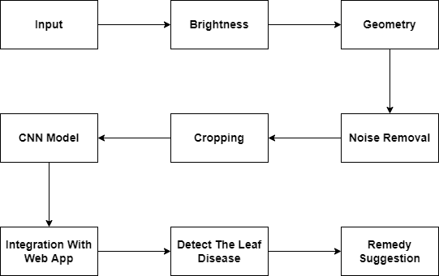
Implementation

Slide 16
Materials:
Plant village Dataset : The Plant village dataset consists of 17500 plant images. The images are divided into 15000 training images and 2500 testing images.
Input Plant Image:
The plant image with size 256px X 256px is given as an input. The image is read using openCV function imread() which returns a 2D or 3D matrix of the input image based on the number of color channels present in the image.
img1 = cv2.imread('/content/drive/MyDrive/plantvillage\_019.png')

Slide 17
Pre-Processing :
Brightness correction : To adjust the brightness of an image, we change the value of all pixels by a constant. Adding a positive constant to all of the image pixel values makes the image brighter. Similarly, we can subtract a positive constant from all of the pixel values to make the image darker.
Geometric Transformation : Geometric transforms permit the elimination of geometric distortion that occurs when an image is captured. A geometric transform is vector function T that maps the pixel (x,y) to a new position (x',y').
Noise removal : The plant images could be affected by the salt and pepper noise and gaussian white noise. Filters such as the gaussian filter is used to remove from plant images.

Slide 18
Cropping : The input image with size 256×256 will be cropped to 224x224 dimension. Then for further processing, only cropped images will be given as an input image. This may lead to information loss, But with removal of region that is not required for plant disease detection will lead to reduce computation time and increase the accuracy .
Designing CNN Structure :
Densenet 201 : DenseNet-201 is a convolutional neural network that is 201 layers deep. You can load a pre-trained version of the network trained on more than a million images from the ImageNet database . The pretrained network can classify images into 1000 object categories, such as keyboard, mouse, pencil, and many animals.
base_model = DenseNet201(include_top=False, input_shape=(224,224,3), weights='imagenet',pooling="avg")

Slide 19
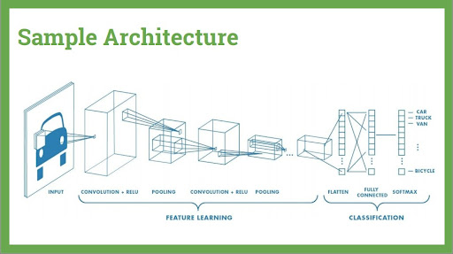
CNN

Slide 20
Convolution Layer : Convolutional layers are the major building blocks used in convolutional neural networks.A convolution is the simple application of a filter to an input that results in an activation. Repeated application of the same filter to an input results in a map of activations called a feature map, indicating the locations and strength of a detected feature in an input, such as an image.
Avg-Pooling Layer : Avg-pooling is a pooling operation that selects the average element from the region of the feature map covered by the filter. Thus, the output after avg-pooling layer would be a feature map containing the most prominent features of the previous feature map.
Relu Activation Function : The rectified linear activation function or ReLU for short is a piecewise linear function that will output the input directly if it is positive, otherwise, it will output zero. It has become the default activation function for many types of neural networks because a model that uses it is easier to train and often achieves better performance.
x = Dense(256,activation = "relu")(x)

Slide 21
Softmax Activation Function : Softmax is a mathematical function that converts a vector of numbers into a vector of probabilities, where the probabilities of each value are proportional to the relative scale of each value in the vector.
Model Training :
To train the model model.fit() is used. To use this function we need to pass in the training data ,batch_size and epochs. the data set is split into 80% for training and 20% for testing.
hist = model.fit(training_set_aug, epochs=30, callbacks=[callback])

Slide 22
Testing :
The trained model is tested for predicting the results.the image to be tested is preprocessed and converted to an array . the trained model and its weights will be loaded and model.predict() will be able to predict the class of a the image.
Integrating The Model With A Web Application :
In order for the user to easily interact with the model and view results, a user interface is required. We have developed a web application using Flask which is a micro web framework written in Python. It is classified as a micro framework because it does not require particular tools or libraries.

Slide 23
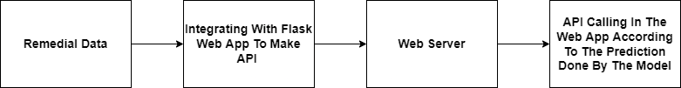
Detecting Plant Leaf Disease :
The trained model is loaded using Load_model. The image to be tested is preprocessed and converted to an array. Using model.predict() will be able to predict the class of the disease the image belongs to and corresponding remedy of the detected disease will also be displayed.
Remedial Suggestion :

Slide 24
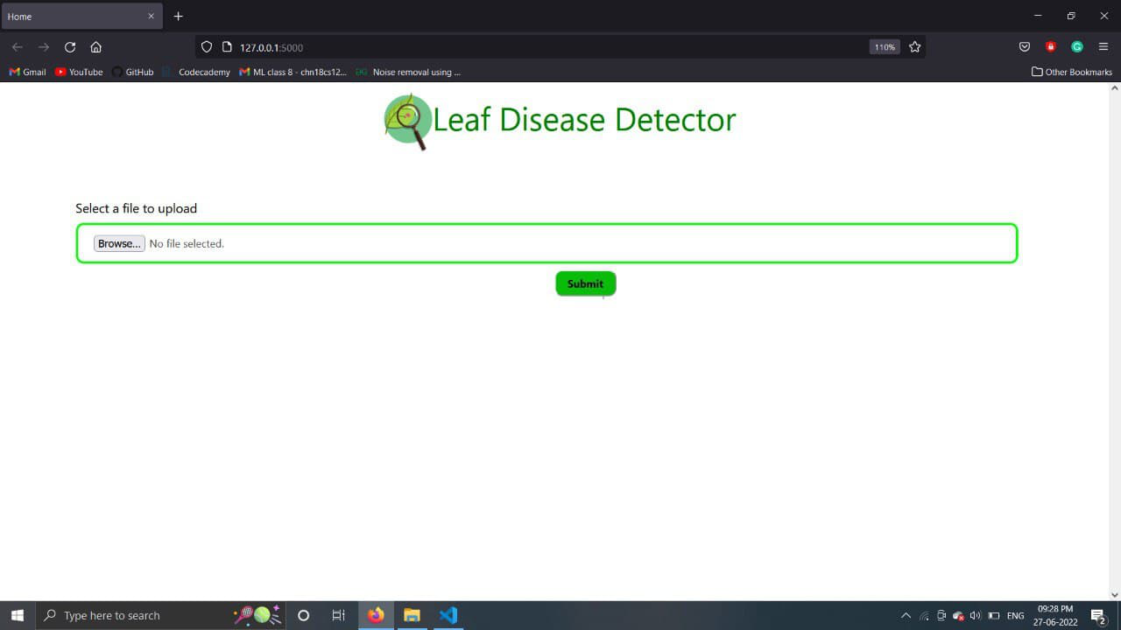
Experimental Results
Initial page of the website which prompts the user to input an image from the dataset.

Slide 25
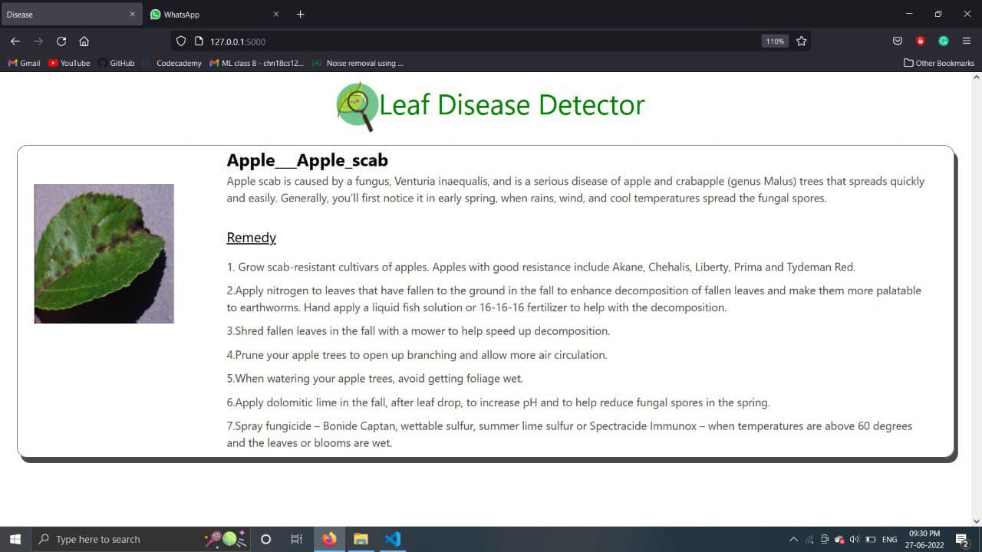
The uploaded image is identified for a particular disease and remedies are suggested in order to make it healthy.

Slide 26
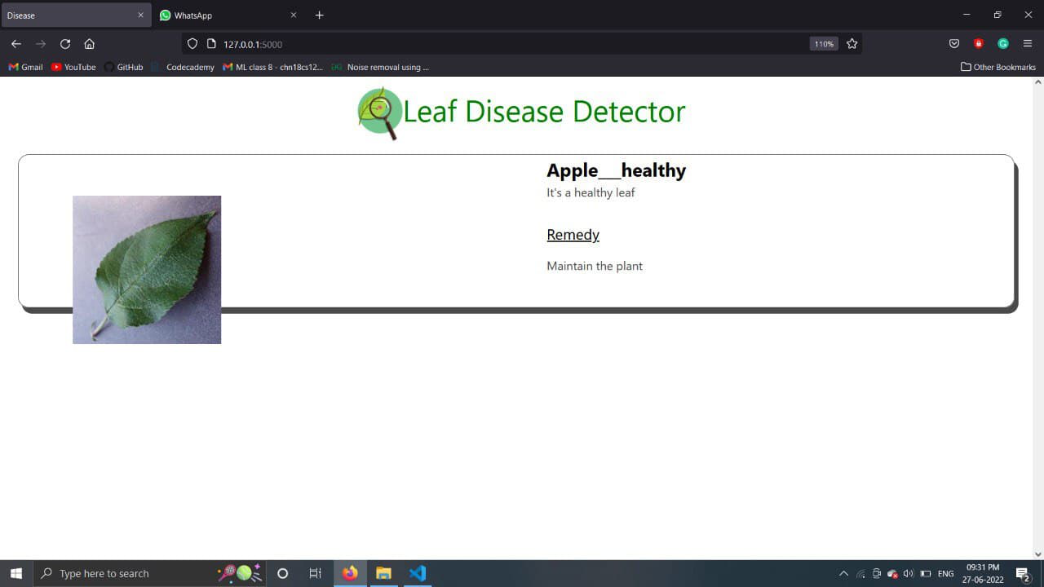
The uploaded image is identified to be healthy.

Slide 27
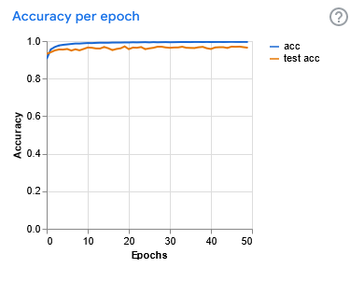
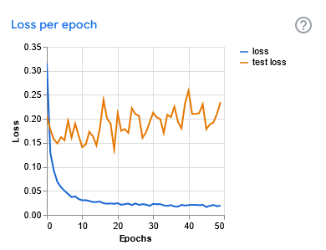
Performance Evaluation

Slide 28
Existing System
AGRIO :
Agrio is an AI-based plant disease identification app.
The app uses images uploaded by users to match with data available with the app’s database and then provides the accurate details of the plant disease treatment.
CROP DOCTOR :
OS – Android
Built by Govt. of India
Farmers can query the information with image from various nutrient deficiencies, disease, insect-affected for obtaining the solution as required.

Slide 29
How Our System Differ
It is a web based application.
Provides the suggestions and remedies for the treatment for the diseased plants.
While some existing applications are paid, our system is a free application.

Slide 30
Limitations
The system deals with the detection of leaf diseases only.
The model may not be 100% accurate and face from overfitting issue.
Dependent on Dataset.
Internet access should be available while using the application.
Dataset doesn’t contain all types of plants and diseases.

Slide 31
Conclusion
There are number of ways by which we can detect disease of plants and suggest remedies for them. Each has some pros as well as limitations .On one hand visual analysis is least expensive and simple method, it is not as efficient and reliable. Image processing is a technique which is most spoken for very high accuracy and least time consumption are major advantages offered.
Recognizing the disease accurately and efficiently is mainly the purpose of the proposed approach. The experimental results indicate that the proposed approach is a valuable approach, which can significantly support an accurate detection of leaf diseases in a little computational effort.

Slide 32
References
[1] A. Anderla D. Culibrk by S. Slado jevic, M. Arsenovic and D. Stefanovic. Deep neural networks based recognition of plant diseases by leaf image classification. Hindawi, 4, 2016.
[2] J. Ubbens and I. Stavness. Corrigendum: deep plant phenomics: a deep learning platform for complex plant phenotyping tasks. frontiersin.org, 2018.
[3] J. Potgieter M. H. Saleem, S. Khanchi and K. M. Arif. Image-based plant disease identification by deep learning meta-architectures. mdpi, 2020.

Slide 33
Thank You

